Slide 1
Summer Internship
Sector Backend

Slide 2
General idea
GDPR Violations
Unencrypted data
Data exchange
NETWORK TRAFFIC
PARSERS check
violations into:
PDF
Word
FRONT END API
VIOLATION API

Slide 3
My Project
PARSERS
HAS/DOES
Directory listing
Check directory/file for
Create
Read
Update
Delete
Informs same Parsers
FILE AGENT
VIOLATION API
FRONT END API

Slide 4

Inside File Agent
Low Level Programming
Win32 Api
Service
Microsoft Documentation
Event Driven Program
Tools:
Visual Studio 2019
SCM(Service Control Manager)
Start
Stop
Restart
Event Viewer

Slide 5

Future Goals
Till now…
Simple Interface
Future..
Add Integration with Parsers

Slide 6


Website Development

Slide 7

Inside Sites
Tool
Wordpress
Plugins System
Themes System
Custom Content Types
WiOpt 2020
Main Structure
Empower
Add a community

Slide 8

WiOpt 2020

Slide 9

Empower
Active Lab Project
Plugin BuddyPress
Add A Community
Group Page
Member Page
Forum
Activity Page

Slide 10
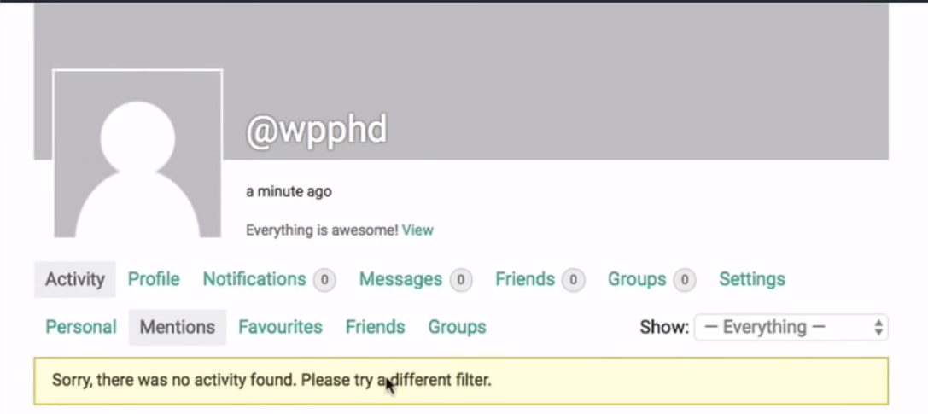
Community

Slide 11
THANK YOU!
Do you have any Questions?

